Slide 1

MANAGING EXPOSURE:
CHEMICAL RISK ASSESSMENT
TOOL
Sypol
User Guide v5.1
()

Slide 2

1: User Guide: Contents
User Guide: Contents (Slide/Pg 2)
Why do need Sypol, if we have SDS’s? (Slide/Pg 3)
How to: LOGIN to system (Slide/Pg 6)
How to: Locate Assessment(s) (Slide/Pg 8)
How to: Print Assessment(s) (Slide/Pg 12)
How to: Print a SDS (Only) (Slide/Pg 13)
How to get an CRA/SDS in another language i.e. translated (to over 40 languages) (Slide/Pg 14)
How to add a new or missing chemical to system
including Support contact information (Slide/Pg 15)

Slide 3
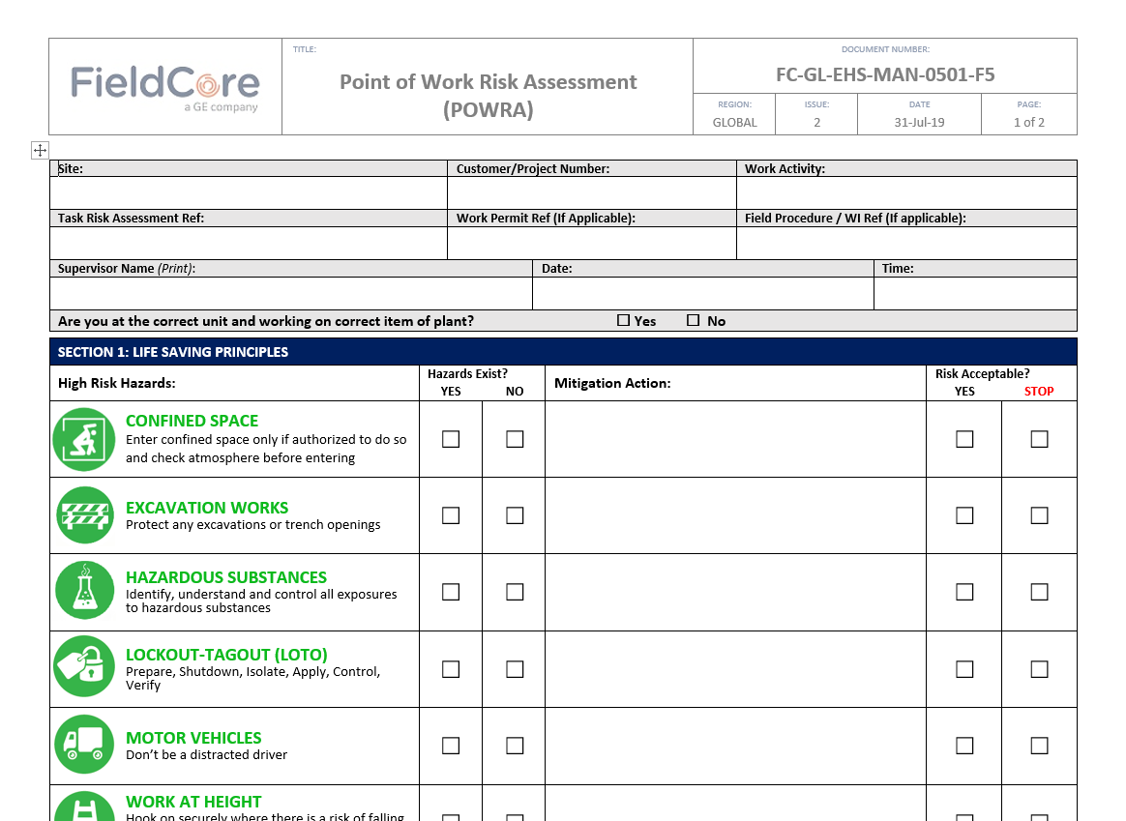
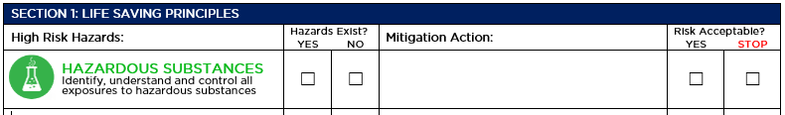
2: Why do need Sypol Chemical Risk assessments, if we have SDS’s?
A MANDATORY requirement within the Life Saving Principles of the POWRA, is to conduct a risk assessment for Hazardous Substances: Identify, understand and control all exposures to hazardous substances.
The Sypol Alcumus CMS (Chemical Management System) has been populated with ALL the Chemicals used within FieldCore and each has an approved risk assessment on “how we use in FieldCore” and what we need to do to control the “hazards associated with them” (i.e., separate specific assessments for usage; spraying, decanting, wiping off Cr(VI) residue) Also covers welding etc that have no SDS
The system also has a digital version (database) of the current/up to date SDS from the supplier. Available to download when needed. (an SDS, is not a risk assessment by itself, it is only a list of (sometimes confusing) regulatory information, the Sypol system, sheets make this into only information you need to protect yourself from the hazards using PPE etc. And quick information on what to do, in the event of a spill or First Aid incident or fire!
USE POWRA to make a final check on the
substances you are working with

Slide 4
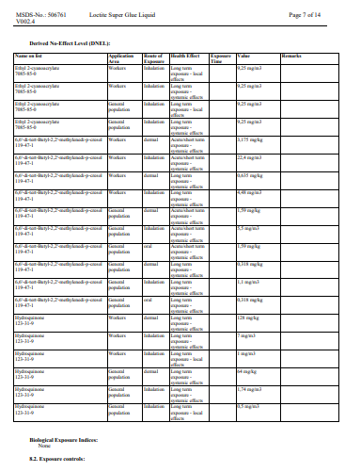
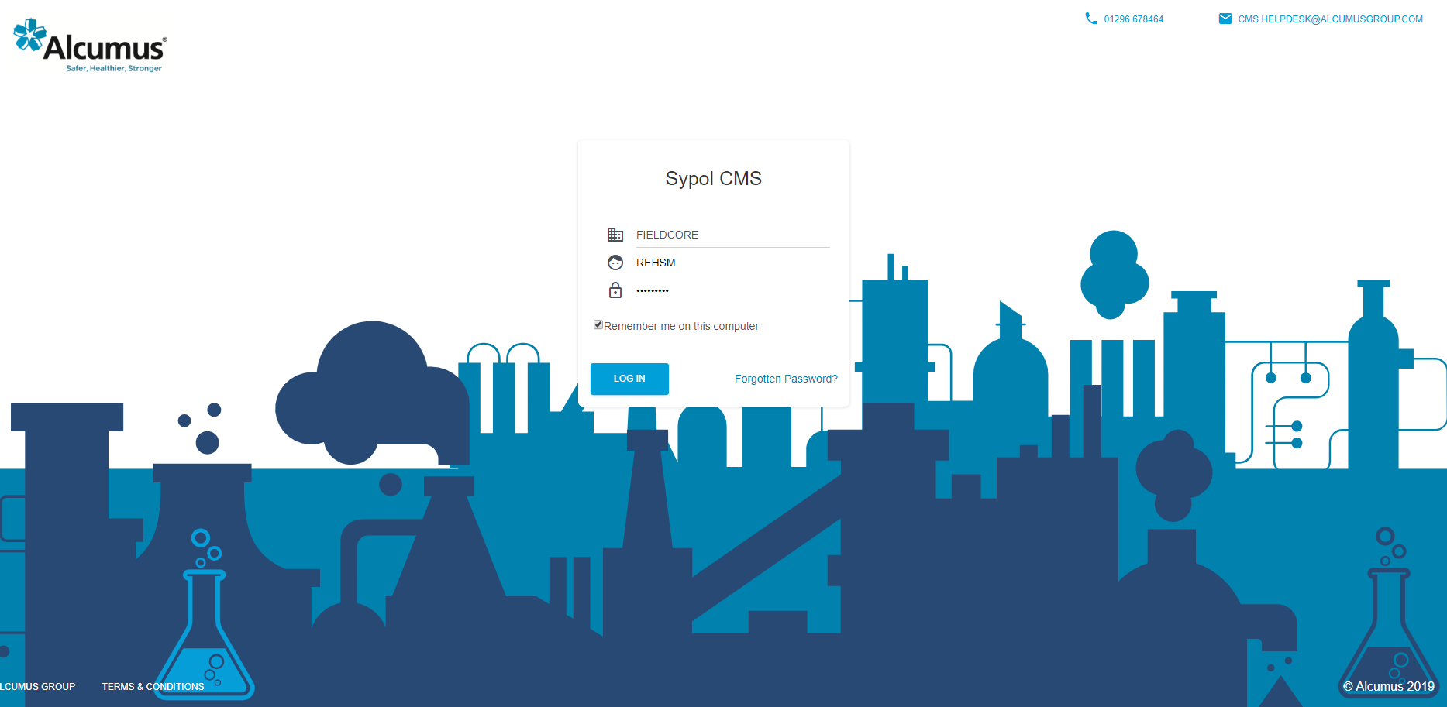
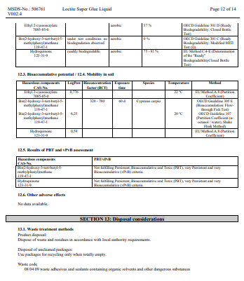
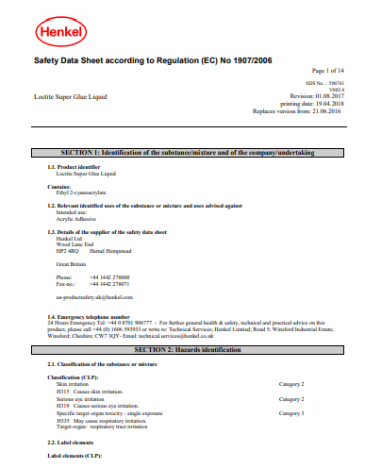
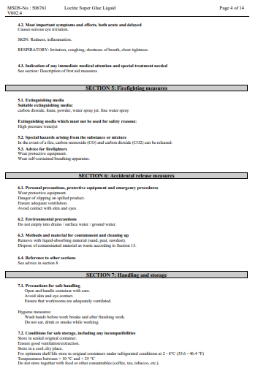
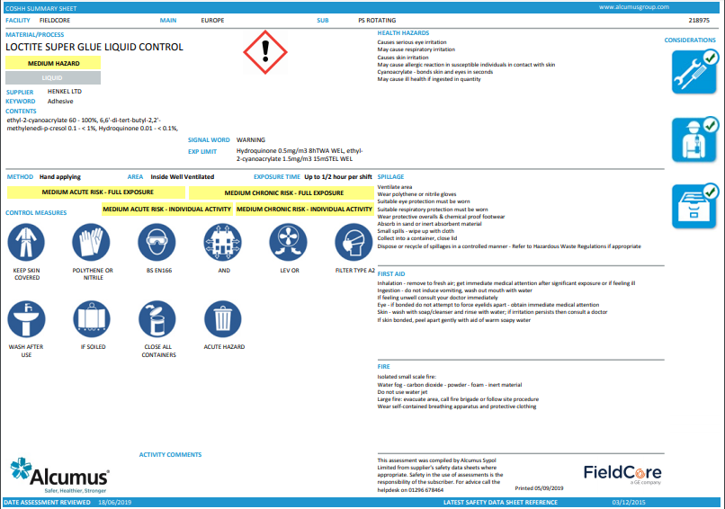
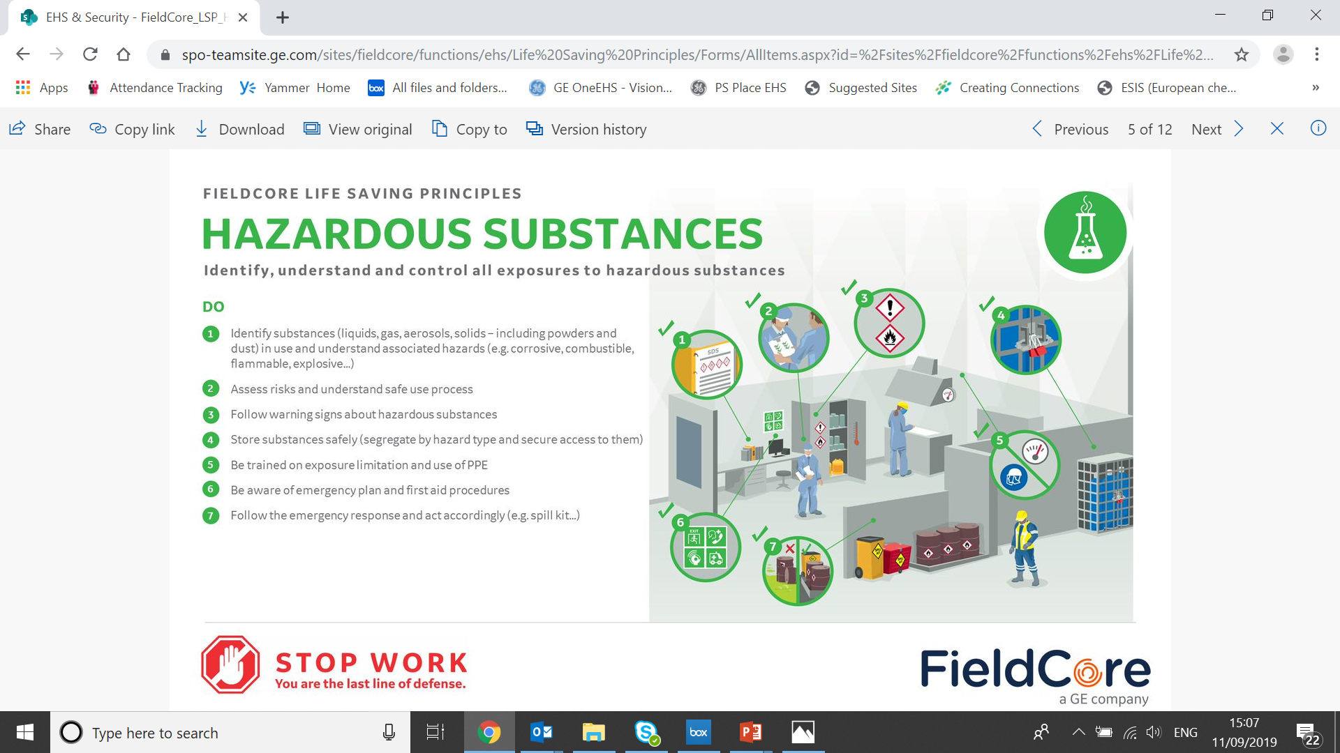
Chemical Risk Assessment – Managing exposure using the Sypol Alcumus System
Make sure you and your team are Ready to Work by:
Having the latest SDS
Determining exposure controls
Performing chemical risk assessment Use Sypol Chemical Risk Assessments Field Guide here
Preparing an emergency plan for (first aid, fire & environmental spill)
Verify and test mitigations in POWRA all is in place, if not - STOP WORK
Hazardous Substances Life Saving Principles
SDS sheets are converted to simple 1-pagers by EHS/IH experts
Follow the controls described in the summary sheet

Slide 5
Controls
Chemical Information
Controls (inc PPE)
Recovery Measures
(in the event of an incident)

Slide 6
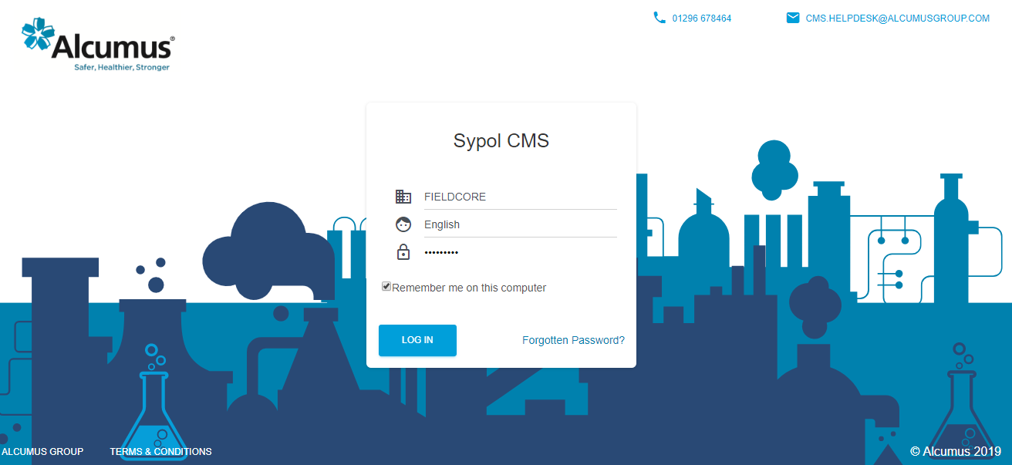
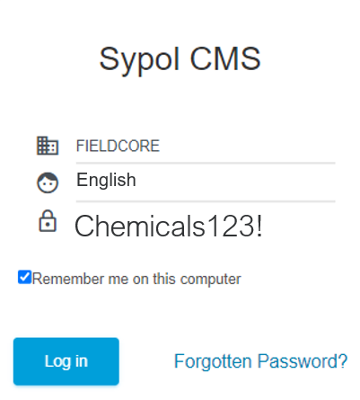
3: How to LOGIN to system
(the software is called SYPOL by Alcumus)
0. Go to: https://cms.sypol.com (in a web browser e.g., chrome)
1. Enter Company ID: FIELDCORE (exactly: field is are case-sensitive)
2. Enter Username: English (assessment will be e.g., English)
3. Enter Password: Chemicals123! (remember to include the “!” after …123)
4. Click Tick box: Remember me on the computer button (saves password)
5. Click: Log in
1
Tip: The default language for Sypol Chemical Risk Assessments (CRA’s) is English, however the FieldCore Sypol support team can assist with translation of assessments in to over 40 languages on request see Section 7
2
3
4
5

Slide 7

3: How to LOGIN to system
English
Tip: (remember to include the “!” after ….123)
Chemicals123!

Slide 8
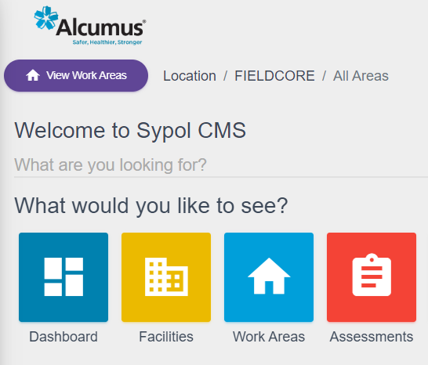
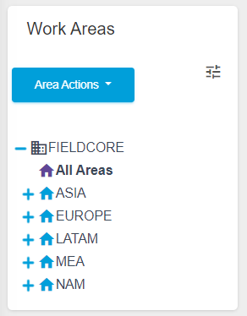
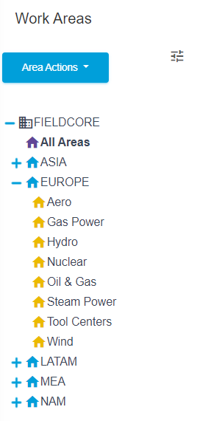
4. How to: Locate Assessment(s)
A new Work Areas page will open;
2. Click on the (+) next to your region
A dropdown menu will open;
3. Click on Service Line e.g. Gas Power
After login, on the home page… to locate CRA’s assessment(s);
1. Click on Work Areas in the center to be taken to the next page
3
2
1

Slide 9
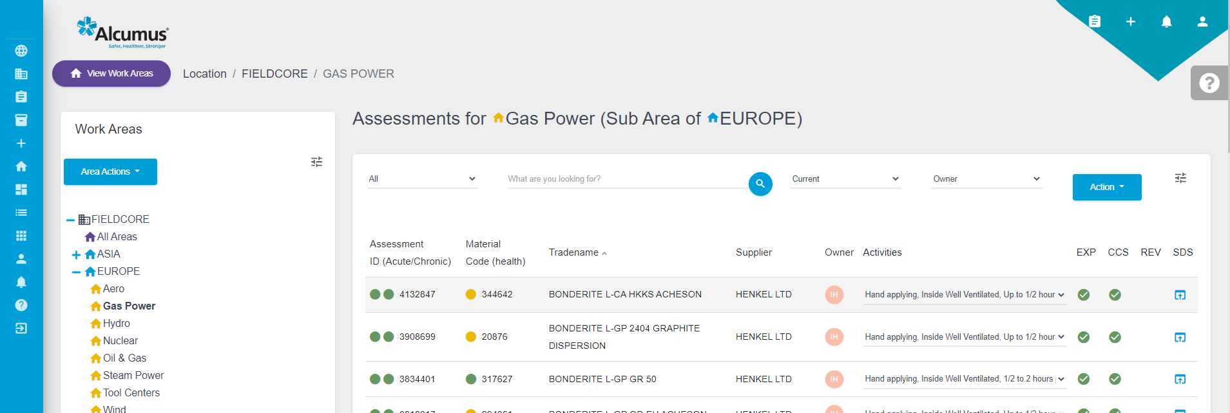


4. How to: Locate Assessment(s) cont…
5
2
4
6
3
4. Click on TradeName of Chemical required OR (scroll down / navigate to required chemical)
5. OR: Use the search facility enter the TradeName then click
6. Select activity that best suits use of chemical (if applicable: duration, indoors/outdoors)
7a. The Chemical line will highlight as grey (and will then open a new page)
7a

Slide 10
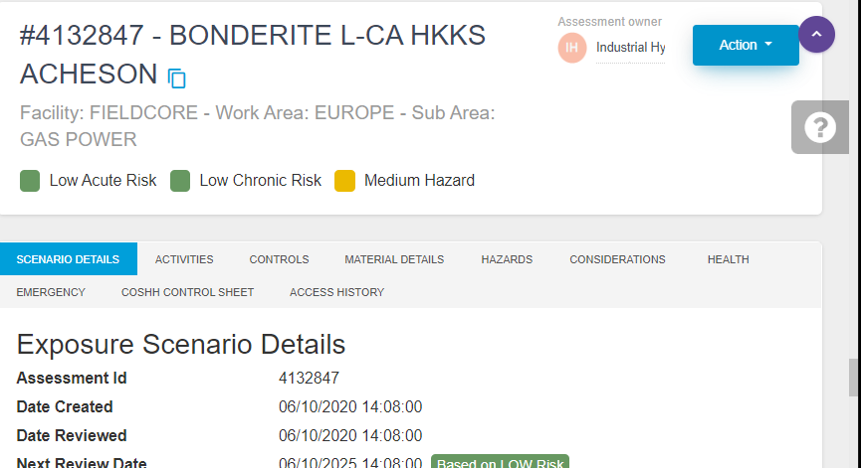
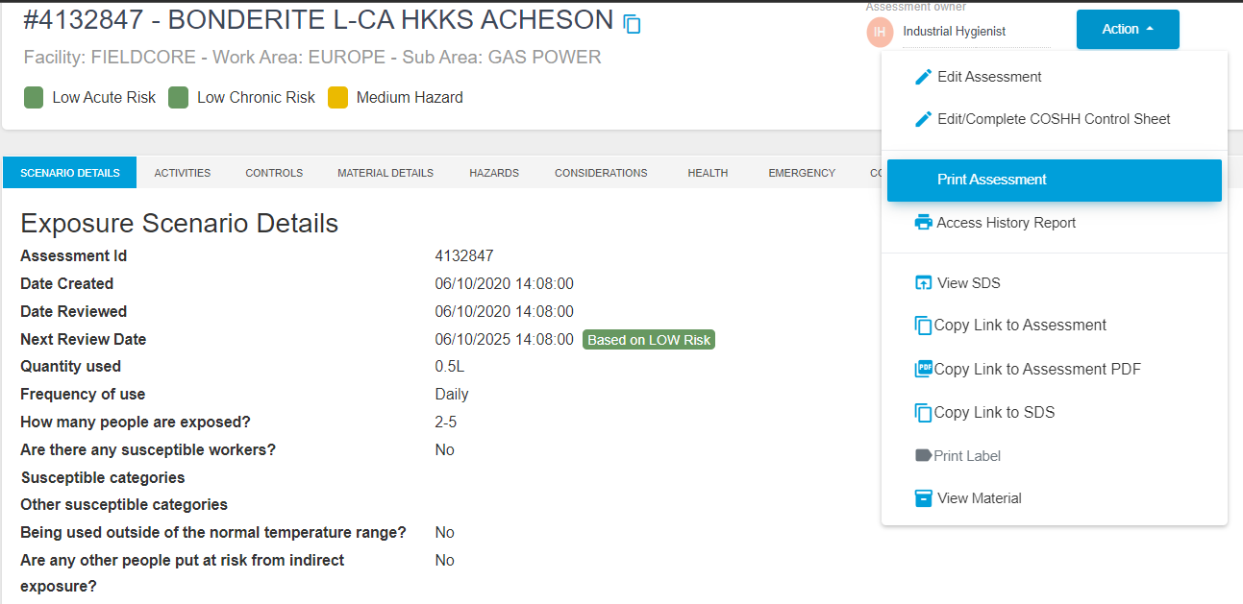
4. How to: Locate Assessment(s) cont…
7b. Click on the Action
8. Click on Print Assessment
7b
8

Slide 11
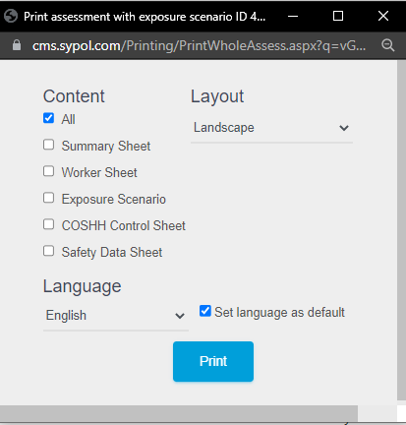
4. How To: Print Assessment(s)
1. In the dropdown menu Select Print Assessment
2. A pop-up box will appear *(see next slide for further instructions).
1

Slide 12
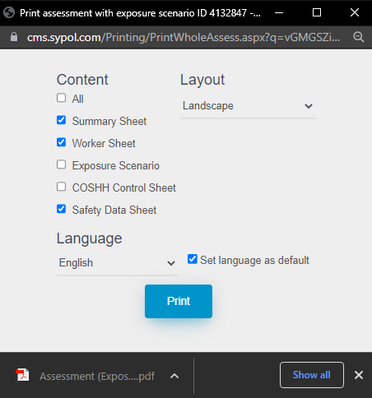
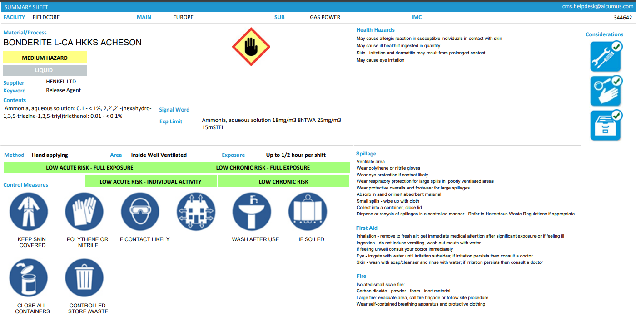
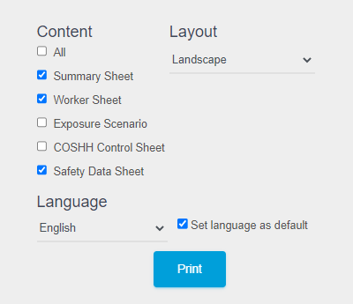
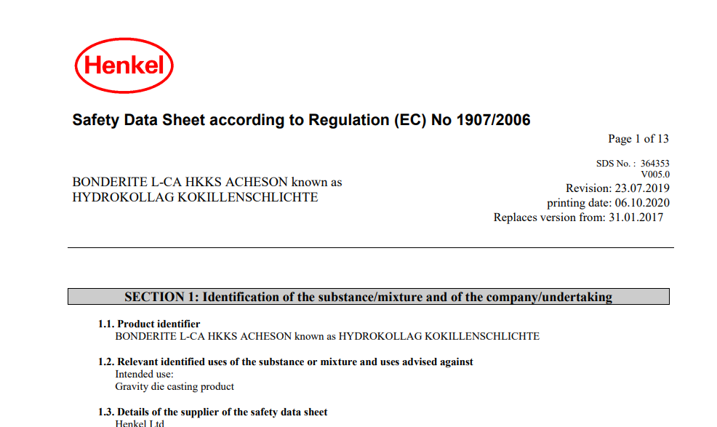
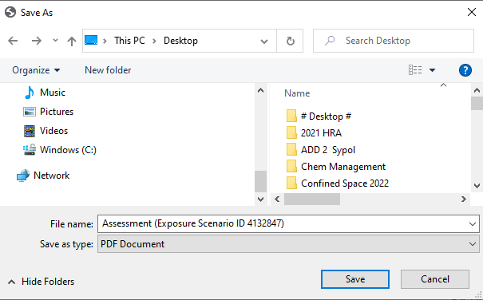
5. How to: Print Assessment(s) cont…
Unclick box: All
Click box: Summary Sheet
Click box: Worker Reference Sheet
Click box: Safety Data Sheet (This attaches SDS to Chemical Risk Assessment)
Click Print (a pop-up box will appear, save it locally to your computer, hint: add the Tradename to filename for easy future location)
After a moment a PDF of the Assessment will be generated (in pop-up window, in Chrome
bottom left, other browsers variation on this.)
The PDF of the Chemical Risk Assessment/SDS can be printed or saved locally (like any other PDF file)
6
7
1
2
3
Tip: The default language for Sypol is English, however the FieldCore Sypol support team can assist with translation of assessments in to over 40 languages on request
(See Section 7)
4
5

Slide 13
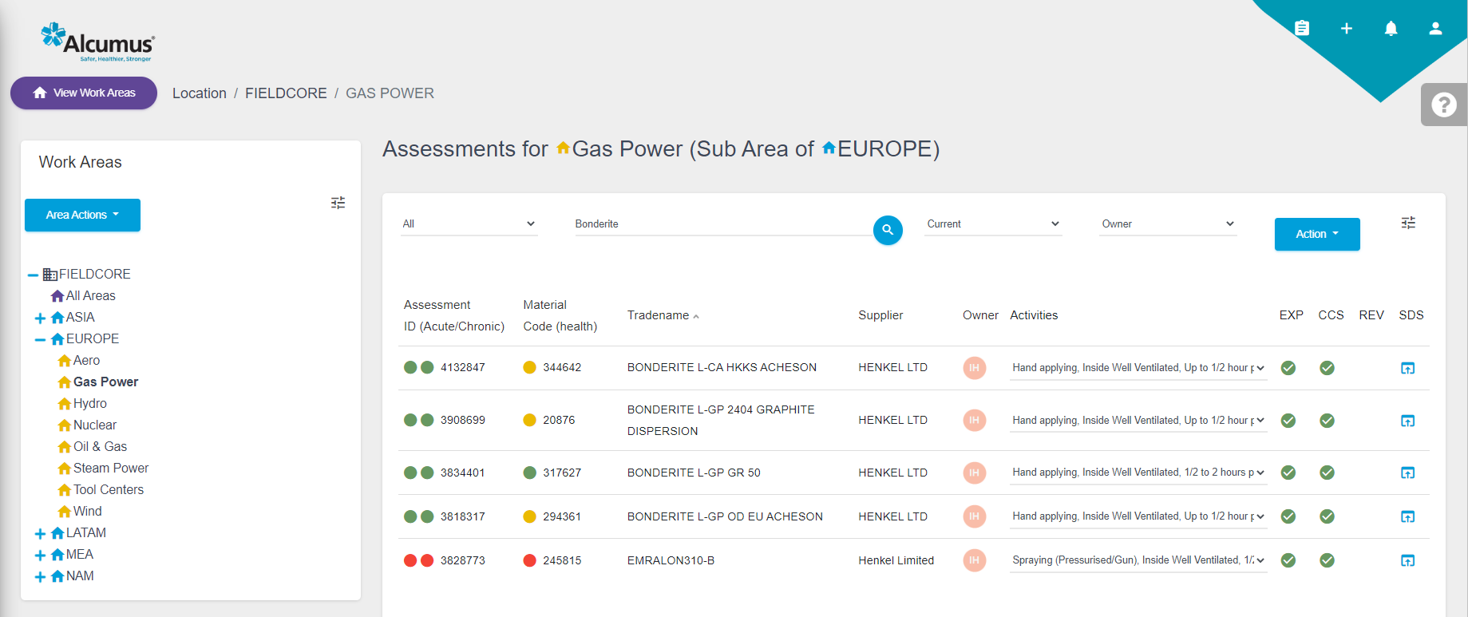
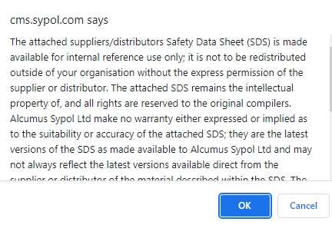
6. How to quickly: Print a SDS (Only)
1
2
3
4
Ensure you have the Chemical required selected (hint: use the search function is fastest)
Click SDS Button (a drop-down menu will appear)
A pop-up box will appear Click OK
After a moment a PDF of SDS generated. The PDF of the SDS can be printed or saved locally . (like any other PDF file)

Slide 14

7. How to get an CRA & SDS in other language(s) (i.e. translated)
Print the assessments you need translated (as pdf) as per Section 5 of this guide (by default they will be in English ) if you select the SDS box this will be translated too.
Email them to FieldCore Sypol CRA Support via: ross.conway@ge.com
Identify the language(s) that you would like the assessment in (Over 40 languages available)
The FC Team translate and send back to you. (to be most effective, in the planning stages of an outage if you know the languages that you will need need, let the team know, to avoid any delays, a box folder can be developed, to allow wide access.
1FS Chemical Risk Assessment Support
ross.conway@ge.com

Slide 15
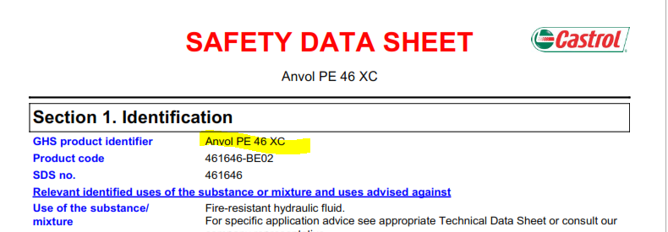
8. Adding/updating a new or missing Chemical(s)
1. If new chemicals are needed on site, or the Sypol system is missing a . CRA for a chemical . Ensure you have an up-to-date PDF (digital) . version of the SDS
FieldCore Chemical Risk Assessment Support
ross.conway@ge.com
2. Email then FieldCore Support: and they will develop the CRA, (if you need it translated into another language other than English let them know too)

